Slide 1
ESSENTIAL QUALITIES
OF A COUNSELLOR
GOOD LISTENER
ETHICAL
TRUST & CONFIDENTIALITY
EMPATHETIC
GENUINENESS
KEEPING PACE
OPEN MINDED
UN BIASED
NON JUDGEMENTAL
CHEERFUL DISPOSITION
PERSONAL WARMTH
APPROACHABILITY

Slide 2
GOD’S POWER AND WISDOM
A Counsellor needs to rely on the Power & Wisdom and Counsel of God
‘My knowledge lacks God’s power but
God’s knowledge comes with His power’.
Rev Isaac Johnson

Slide 3
CHRISTIAN COUNSELLORS ARE :
2 Cor 4:7 : ‘But we have this treasure in jars of clay to show that this all-surpassing power is from God and not from us.’
JARS OF CLAY EMPTY OURSELVES BE HUMBLE TREASURE POWER FROM GOD

Slide 4
WHEN YOU HAVE TROUBLES :
2 Cor 1:3b,4 ‘…… the Father of compassion and the God of all comfort, who comforts us in all our troubles, so that we can comfort those in any trouble with the comfort we ourselves have received from God.’
YOUR TROUBLES COMFORT FROM
        CHRIST
COMFORT HEALED
TO OTHERS

Slide 5
ETHICS
DO NOT TAKE GIFTS/FAVOURS from the Counsellee/Client
DO NOT USE THE GOOD OFFICES OF CLIENT FOR YOUR BENEFIT
DO NOT PROMOTE MARKETING OR BUSINESS THROUGH CLIENT
MAINTAIN PROFESSIONAL DISTANCE
AVOID attending SOCIAL FUNCTIONS with Counsellee
AVOID PERSONAL RELATIONSHIPS WITH COUNSELLEE
DO NOT EXPLOIT YOUR CLIENT IN ANY WAY, PSYCHOLOGICALLY, PHYSICALLY OR SOCIIALLY ….

Slide 6
CONFRONTATIONAL SKILLS
CHANGE THROUGH TEACHING :
THOUGHTS LEADING TO WORDS,
WORDS TO ACTION,
AND ACTION TO BEHAVIOUR.
CONFRONTATIONAL SKILLS :
WRONG THINKING LEADS TO WRONG FEELINGS & BEHAVIOUR
RIGHT THINKING LEADS TO RIGHT FEELINGS AND RIGHT BEHAVIOUR

Slide 7

GOOD LISTENER

Slide 8
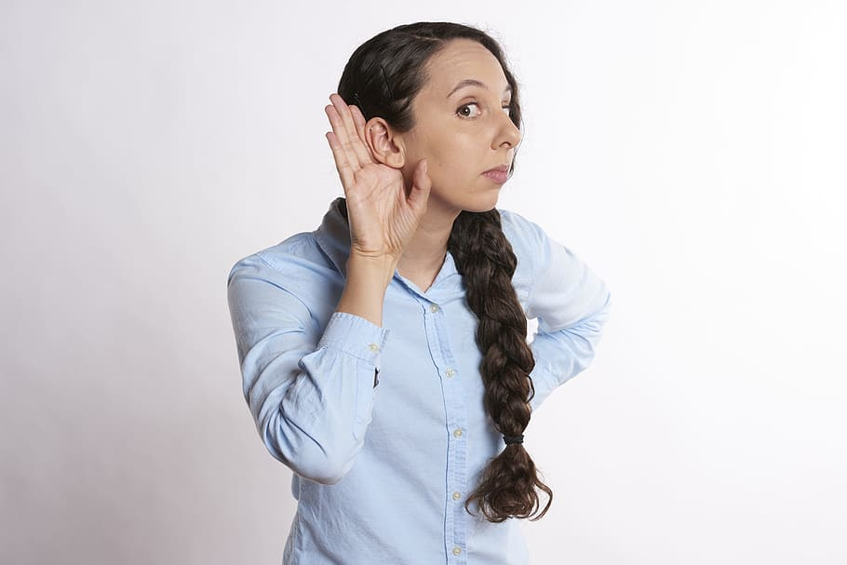
GOOD LISTENER

Slide 9
GOOD LISTENER
WITH PATIENCE
We hear but do not listen !
Most essential skill of a Counsellor is LISTENING
75% of Counselling is Listening …
Hearing is to gain information for oneself
LISTENING is to hear beyond what the other person is trying to communicate …..
LISTEN with your heart ….
Be empathetic ….
Lots of patience to keep pace with counsellee

Slide 10

TRUST &
CONFIDENTIALITY
Build trust with the counsellee - it is
important to keep building on it
Counsellor should maintain CONFIDENTIALITY at all times …
Assure the counsellee that none of the conversations would be leaked out
Maintain confidentality of counselling sessions
Not adviseable to share prayer request in prayer groups.
Be cautious about Self-disclosure

Slide 11
EMPATHY
Empathy is the ability to stand in the other person/s shoes – to see the world as they see it.
It involves a ‘forgetting of self’ .
Without accepting (we may not agree) the other person’s view, we run the danger of moralizing, advising and guiding.
Builds rapport between counsellor and counsellee.

Slide 12
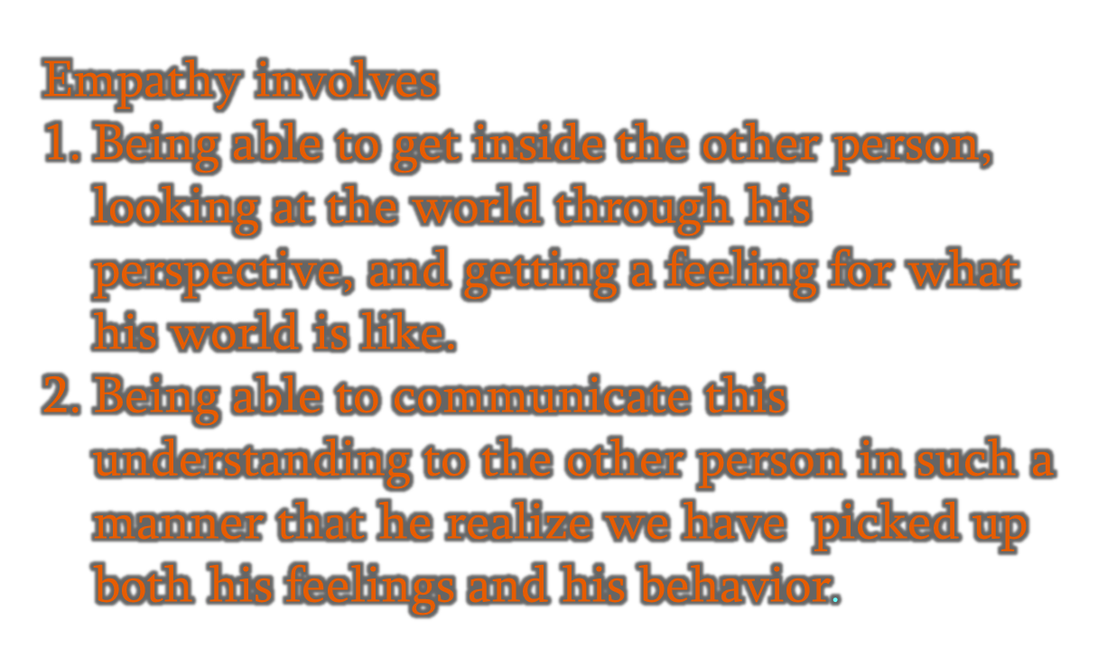
EMPATHETIC

Slide 13
EMPATHY VS SYMPATHY
A drowning man …
Sympathy is standing on th shore and throwing a life ring & advising the person who is struggling in the water….
Empathy is diving into the cold water and bringing him to safety.
Every act of accurate empathy is like a little carving from a sculptor’s chisel, causing you to have a slightly new perspective.
It fashions a heart that is more closely aligned with Jesus.
For the Lord comforts His people and will have compassion on His afflicted ones….
(Ps 86.:15)

Slide 14
GENUINENESS
The Importance of Genuineness in Counselling was pointed out both by Rogers and Truax (1967)
It is the INTENT rather than a Public Front
(like front office staff and managers in hotels, airlines, fast food chains, super markets etc )

Slide 15
KEEPING PACE WITH THE COUNSELLEE
Jesus and His Walk to Emmau…
Open ended questions ; body language and problems; listened without speaking; alternate frame of reference; challenged them ; established good relations; rapport; terminated his time; reflected and communicated to others and allowed them to discover for themselves.
He did not impose or try to influence them.
Jumping to conclusion :- no
Pushing the counsellee into decision-making :- no
No Advice ….
No problem-solving by you -- the Counsellor.

Slide 16
ATTITUDE
Respect the counsellee
OPEN MINDED
UN BIASED
NON JUDGEMENTAL
No ‘I’m OK, you’re NOT OK’ attitude
No Superiority Complex
Our Self- worth is in Christ

Slide 17
WHAT COUNSELLING IS NOT !
A glamorous activity of giving advice
Of passing judgement
A ‘feel good’ attitude about oneself
Being biased
The difference between advice and counselling :
Advice : telling the Counsellee what to do, and how to go about solving their problems {which most of the time is not followed}
Counselling : making the counsellee see things clearly and, helping them to find solutions to their problems/situations, by themselves…..

Slide 18
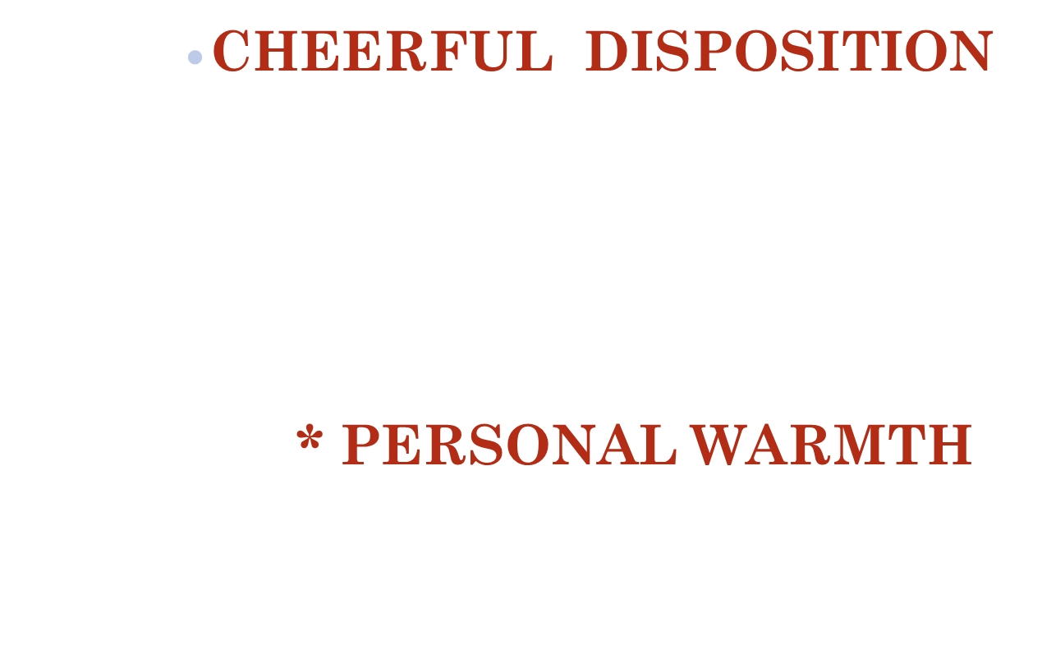

ATTITUDE

Slide 19
APPROACHABILITY
APPROACHABILITY
‘....... Always be prepared to give an answer to everyone who asks you to give the reason for the hope that you have. But do this with gentleness and respect, ….’1 Peter 3:15 NIV.
‘…… and always be ready to give a defense to everyone who asks you a reason for the hope that is in you, with meekness and fear; ……’
1 Peter 3 : 15 (Open Bible ).

Slide 20
WHAT TO DO IF THINGS GO WRONG ?
Don’t Panic
Continue to listen…..
Ensure that you know where the client is going after the counselling session
Suggest that someone be brought into the counselling session
Telephone for help – if worried
Keep a list of telephone/mobile numbers of Mentor, Agencies, Psychotherapists, Psychiatrists etc.

Slide 21
GOAL SETTING & ACTION PLAN
During implementation of action plan
Keep a low profile
Avoid excess ‘fathering’ or ‘mothering’
Be supportive and encouraging
Be available

Slide 22
ENDING THE COUNSELLING SESSIONS
SENDING THE COUNSELLEE BACK TO THEIR LIVES :
Who ends it ?
How to say goodbye
Occasional follow up calls can be made
Wean them away from depending on you for every problem they may confront after the counselling sessions are over …
Problem solving techniques – encourage them to put into practice

Slide 23
LIMITATIONS & BOUNDARIES OF A COUNSELLOR
Counsel people of same sex
Time
Place of holding sessions
Privacy and confidentiality
Self-disclosure
Avoid physical contact
Non-sexual touching (allowable under boundary crisis like trauma crisis etc.)
Boundary violations : Touching may be misconstrued as sexual overtures & therefore disallowable under boundary violations .

Slide 24
JOURNAL, DIARY & RECORDS
Details of counsellee and the case evaluation can be maintained in a journal or diary.
During subsequent sessions, the diary is of much help, as it jogs our memory about the details of the case and our analysis & assessment made.
If Counselling of those with suicidal tendencies has been carried out, the journal/diary would service as a record/evidence, in case the counsellee commits suicide….

Slide 25
THE ‘LARRY CRAB’ WAY
  1/ Identify negative (sinful) feelings (which are compounded by negative behaviour)
  2/ Identify negative (sinful) behaviour (which alongwith negative feelings, is caused by wrong thinking)
  3/ Identify wrong (sinful ) thinking
  4/ Promote right thinking
  5/ Plan right behaviour (produced by right thinking)
  6/ Identify satisfying feelings (produced by right behaviour and right thinking)
  Larry Crab in his book
  ‘Basic Principles of Biblical Counselling’
  pg 47

